Slide 1
Support Vector Machine (SVM)
Chih-Sheng (Tommy) Huang
Chih.sheng.huang821@gmail.com

Slide 2
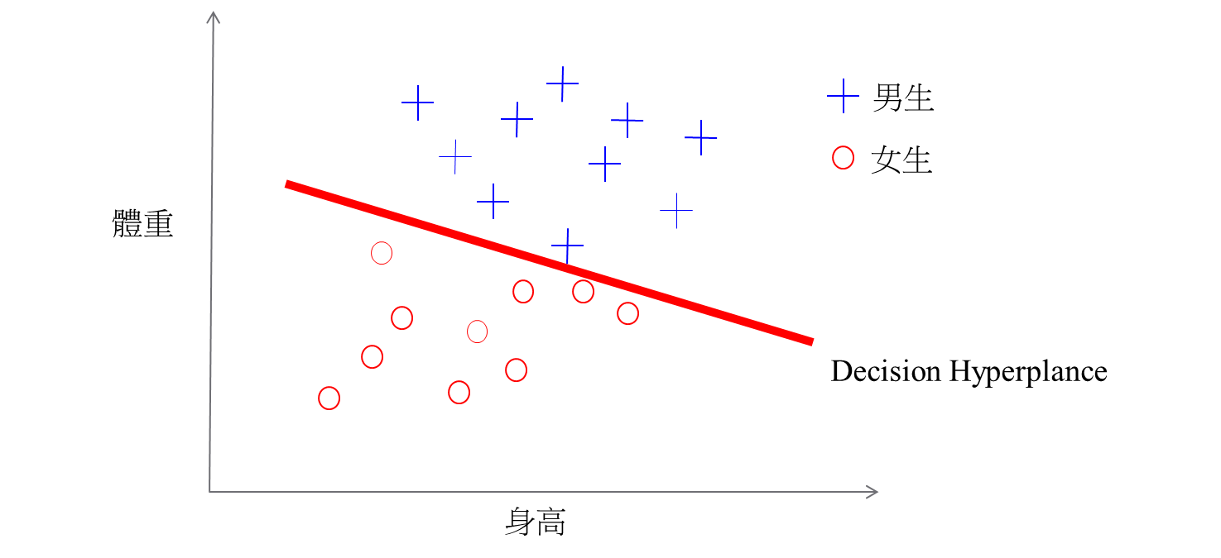
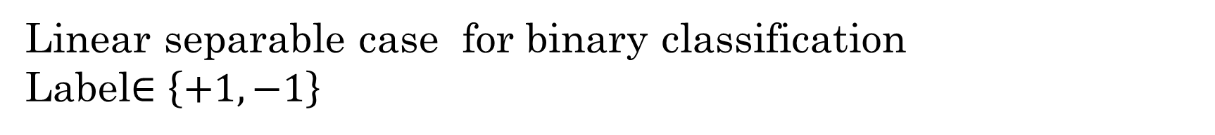
Binary classification
Linear separable case for binary classification
Label$∈\left\{+1,−1\right\}$

Slide 3
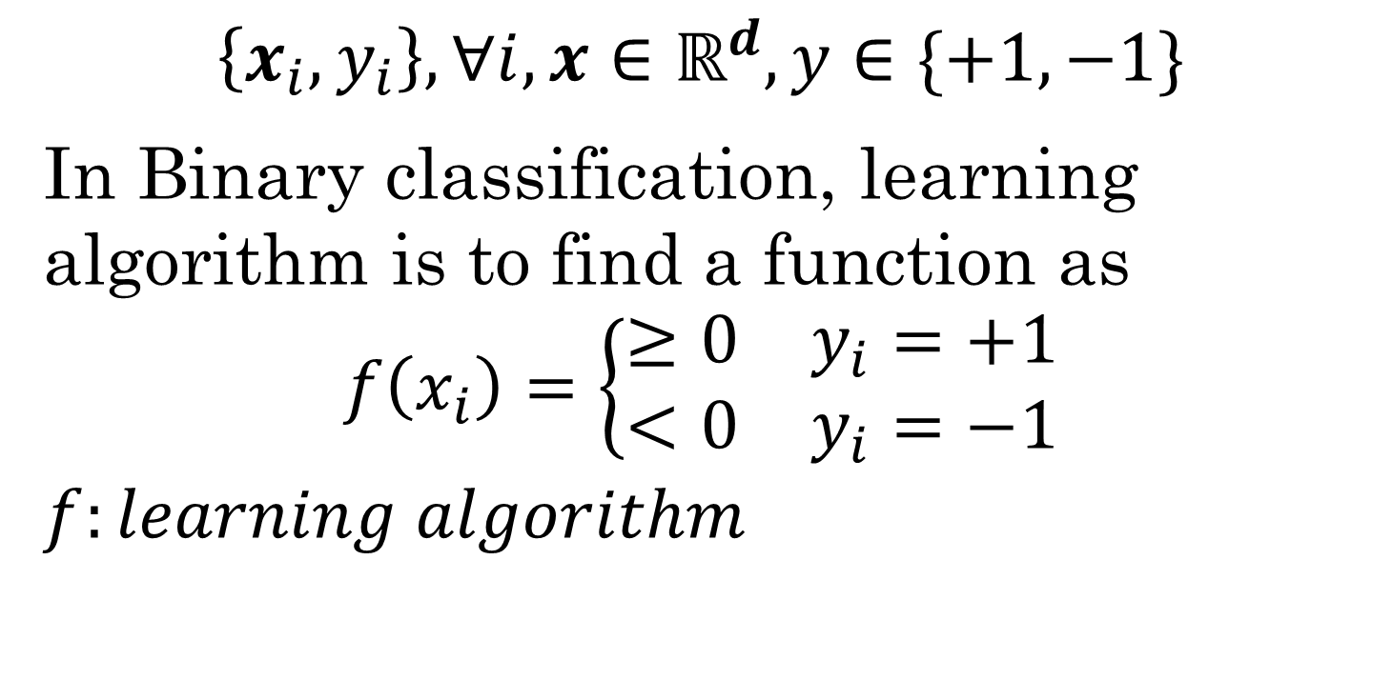
Binary classification
$$\left\{x_{i},y_{i}\right\}, ∀i, x∈ℝ^{d},y∈\{+1, −1\}$$
In Binary classification, learning algorithm is to find a function as
$$f\left(x_{i}\right)=\left\{\begin{matrix}≥0 & y_{i}=+1 \\ <0 & y_{i}=−1\end{matrix}\right.$$
$$f:learning algorithm$$

Slide 4

Binary classification
$$f\left(x_{i}\right)=\left\{\begin{matrix}≥0 & y_{i}=+1 \\ <0 & y_{i}=−1\end{matrix}\right.$$
In other aspect,
$$f\left(x_{i}\right)y_{i}>0$$
means $x_{i}$ has a correct classification.

Slide 5
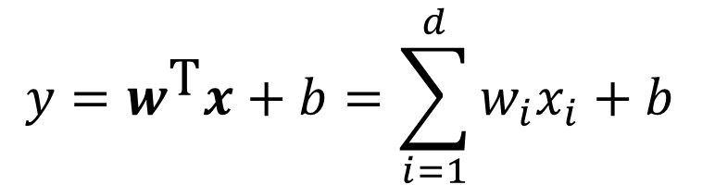
Linear classification
男生
女生
體重
$$y=w^{\text{T}}x+b=\sum_{i=1}^{d}{w_{i}x_{i}}+b$$
身高

Slide 6
SVM
Support vector machine (SVM)
Wide margin
Cost function
Slack variables
Optimization

Slide 7
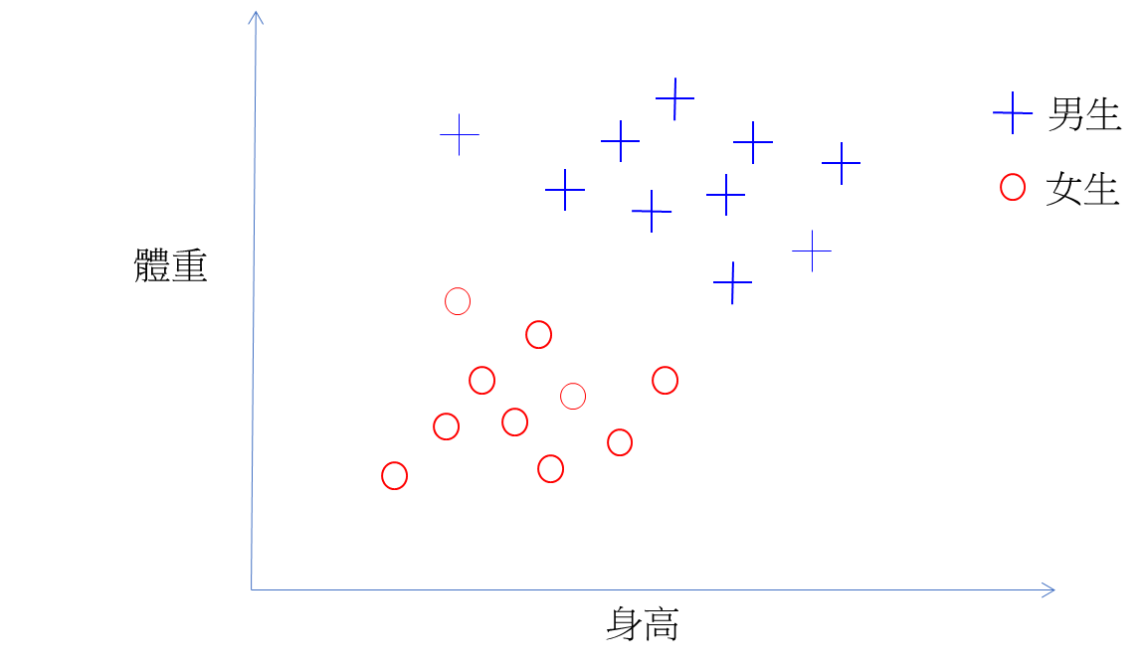
SVM - Wide margin
Remember: Classification learning algorithm is try to learn the separating line (linear or non-linear) close to training data.
Notes:
• if the data is linearly separable, then the algorithm will converge
• convergence can be slow …
• separating line close to training data
• we would prefer a larger margin for generalization

Slide 8
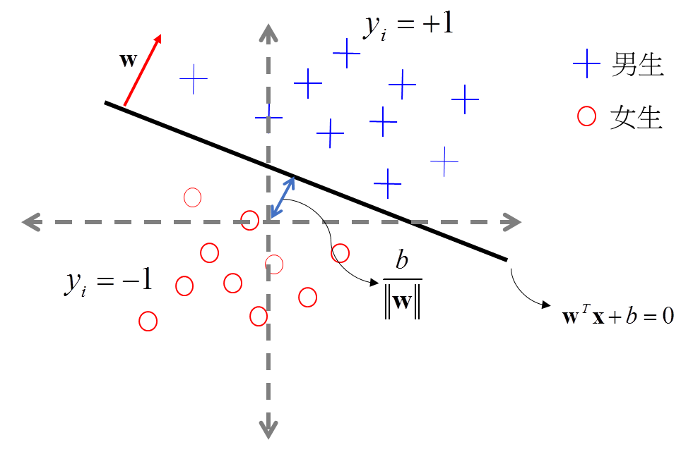
SVM - Wide margin

Slide 9
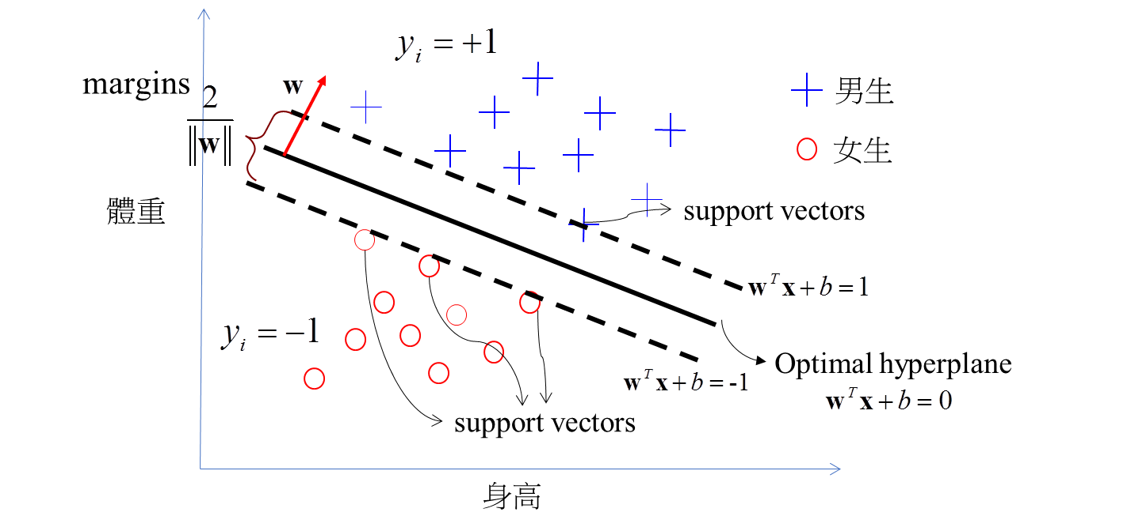
SVM - Wide margin
SVM is try to find the larger margin for separating the training data in binary case.

Slide 10

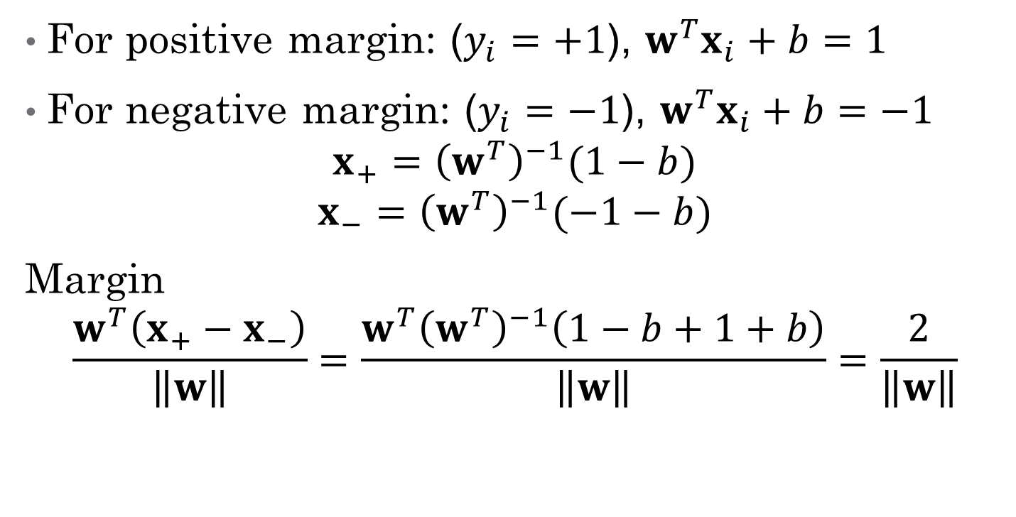
Why margin = $\frac{2}{\left\|w\right\|}$
For positive margin: ($y_{i}=+1$), $w^{T}x_{i}+b=1$
For negative margin: ($y_{i}=−1$), $w^{T}x_{i}+b=−1$
$$x_{+}={\left(w^{T}\right)}^{−1}(1−b)$$
$$x_{−}={\left(w^{T}\right)}^{−1}(−1−b)$$ Margin
$$\frac{w^{T}\left(x_{+}−x_{−}\right)}{\left\|w\right\|}=\frac{w^{T}{\left(w^{T}\right)}^{−1}\left(1−b+1+b\right)}{\left\|w\right\|}=\frac{2}{\left\|w\right\|}$$
Notes:
w>
³
x+ − x−
´
||w||
=

Slide 11
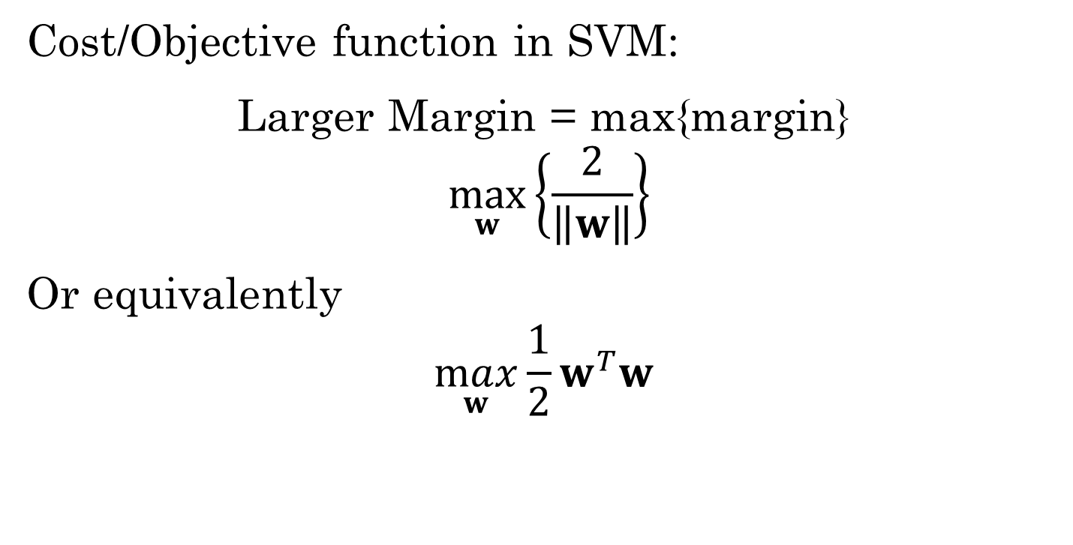
SVM – cost function
Cost/Objective function in SVM:
Larger Margin = max{margin}
$$\max_{w}\left\{\frac{2}{\left\|w\right\|}\right\}$$
Or equivalently
$$\max_{w}{\frac{1}{2}}w^{T}w$$

Slide 12
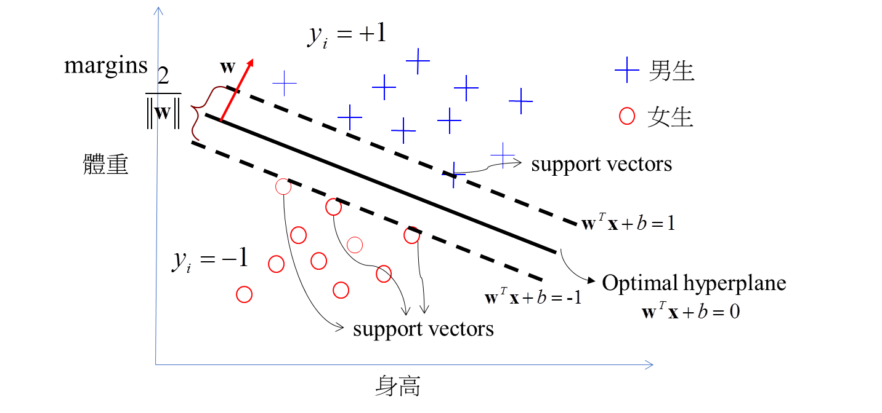
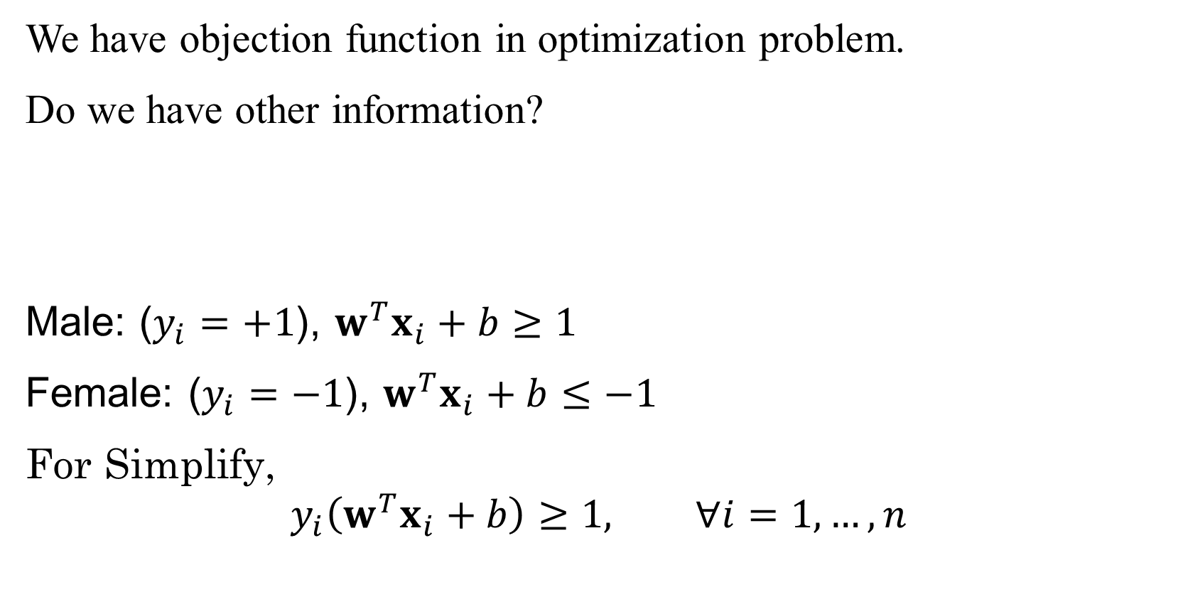
SVM
We have objection function in optimization problem.
Do we have other information?
Male: ($y_{i}=+1$), $w^{T}x_{i}+b≥1$
Female: ($y_{i}=−1$), $w^{T}x_{i}+b≤−1$
For Simplify,
$$y_{i}\left(w^{T}x_{i}+b\right)≥1, ∀i=1,…,n$$

Slide 13

Optimization
Formula of SVM:
$$\max_{w}{\frac{1}{2}}w^{T}w$$
Subject to
$$y_{i}\left(w^{T}x_{i}+b\right)≥1, ∀i=1,…,n$$

Slide 14
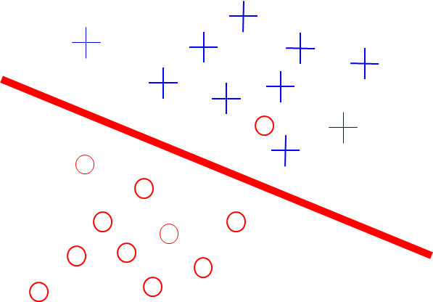
SVM
Not all case can be perfect separated.
How to overcome this problem?

Slide 15
Slack variables
In general, there is a trade off between the margin and the number of mistakes on the training data.
margins
optimal hyperplane

Slide 16
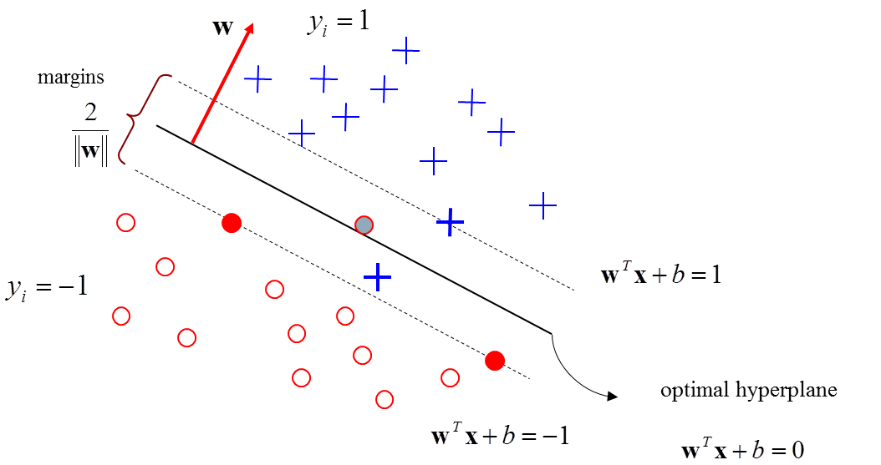
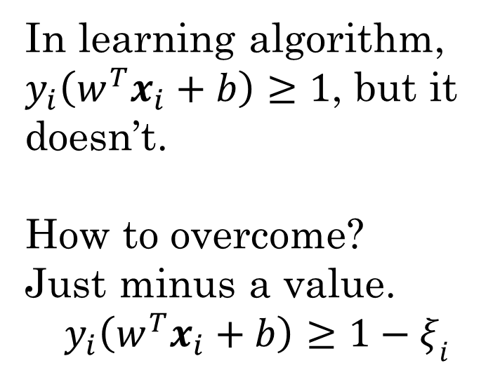
Slack variables
In learning algorithm, $y_{i}\left(w^{T}x_{i}+b\right)≥1$, but it doesn’t.
How to overcome?
Just minus a value.
$$y_{i}\left(w^{T}x_{i}+b\right)≥1−ξ_{i}$$
Slack variable
Notes:
仔細看上圖落於邊界內的樣本點，是不是都有一個特性，舉最下面的+為例，此點的$y_{i}\left(w^{T}x_{i}+b\right)$理論上應該要>=1，但因為可以容忍誤差，所以此點的$y_{i}\left(w^{T}x_{i}+b\right)<1$了。原本的數學寫法是$y_{i}\left(w^{T}x_{i}+b\right)≥1$，所以我們只要在式子右邊減去一個值，就可以達到<=1的情形。

Slide 17
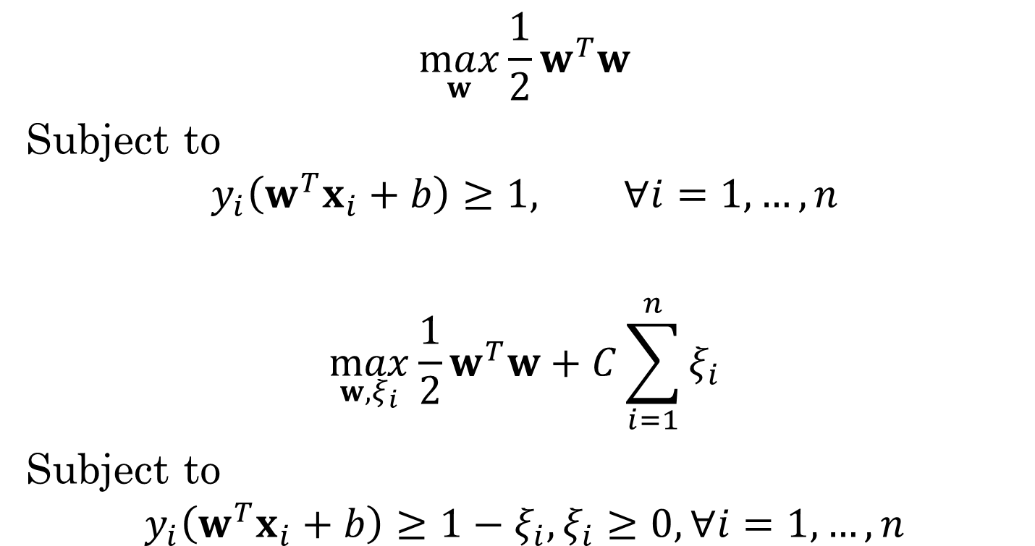
Formula of SVM
Hard Margin SVM
$$\max_{w}{\frac{1}{2}}w^{T}w$$
Subject to
$$y_{i}\left(w^{T}x_{i}+b\right)≥1, ∀i=1,…,n$$
$$\max_{w, ξ_{i}}{\frac{1}{2}}w^{T}w+C\sum_{i=1}^{n}{ξ_{i}}$$
Subject to
$$y_{i}\left(w^{T}x_{i}+b\right)≥1−ξ_{i},ξ_{i}≥0, ∀i=1,…,n$$
Soft
Margin SVM

Slide 18
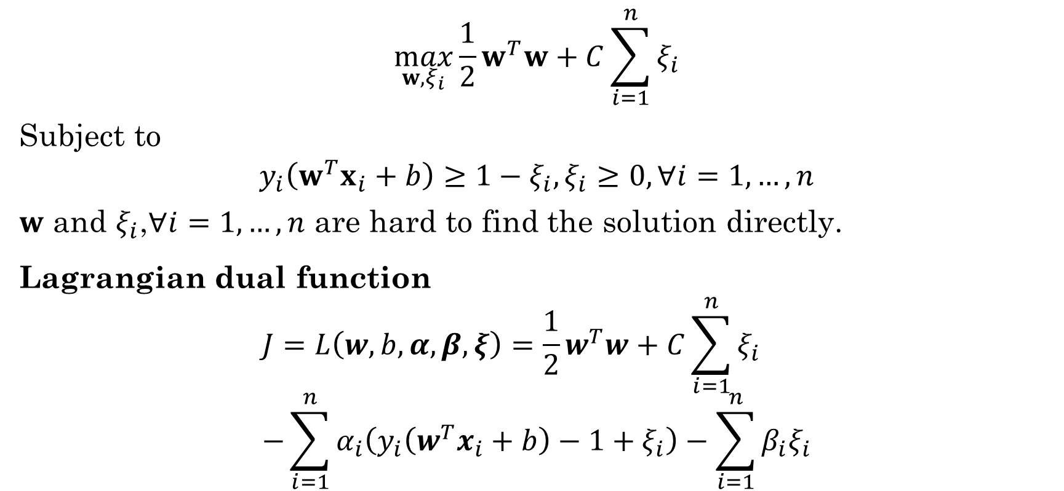
Dual Problem
$$\max_{w, ξ_{i}}{\frac{1}{2}}w^{T}w+C\sum_{i=1}^{n}{ξ_{i}}$$
Subject to
$$y_{i}\left(w^{T}x_{i}+b\right)≥1−ξ_{i},ξ_{i}≥0, ∀i=1,…,n$$
$w$ and $ξ_{i}$,$∀i=1,…,n$ are hard to find the solution directly.
Lagrangian dual function
$$J=L\left(w,b,α,β,ξ\right)={\frac{1}{2}w}^{T}w+C\sum_{i=1}^{n}{ξ_{i}} \\ −\sum_{i=1}^{n}{α_{i}\left(y_{i}\left(w^{T}x_{i}+b\right)−1+ξ_{i}\right)}−\sum_{i=1}^{n}{β_{i}ξ_{i}}$$

Slide 19
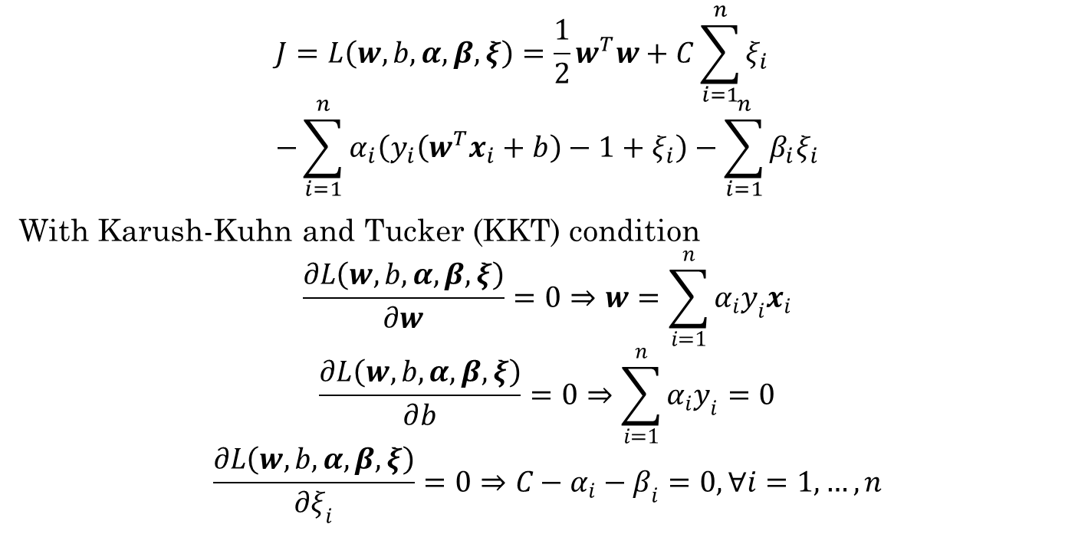
Dual formula
$$J=L\left(w,b,α,β,ξ\right)={\frac{1}{2}w}^{T}w+C\sum_{i=1}^{n}{ξ_{i}} \\ −\sum_{i=1}^{n}{α_{i}\left(y_{i}\left(w^{T}x_{i}+b\right)−1+ξ_{i}\right)}−\sum_{i=1}^{n}{β_{i}ξ_{i}}$$
With Karush-Kuhn and Tucker (KKT) condition
$$\frac{∂L\left(w,b,α,β,ξ\right)}{∂w}=0⇒w=\sum_{i=1}^{n}{α_{i}y_{i}x_{i}}$$
$$\frac{∂L\left(w,b,α,β,ξ\right)}{∂b}=0⇒\sum_{i=1}^{n}{α_{i}y_{i}}=0$$
$$\frac{∂L\left(w,b,α,β,ξ\right)}{∂ξ_{i}}=0⇒C−α_{i}−β_{i}=0, ∀i=1,…,n$$

Slide 20
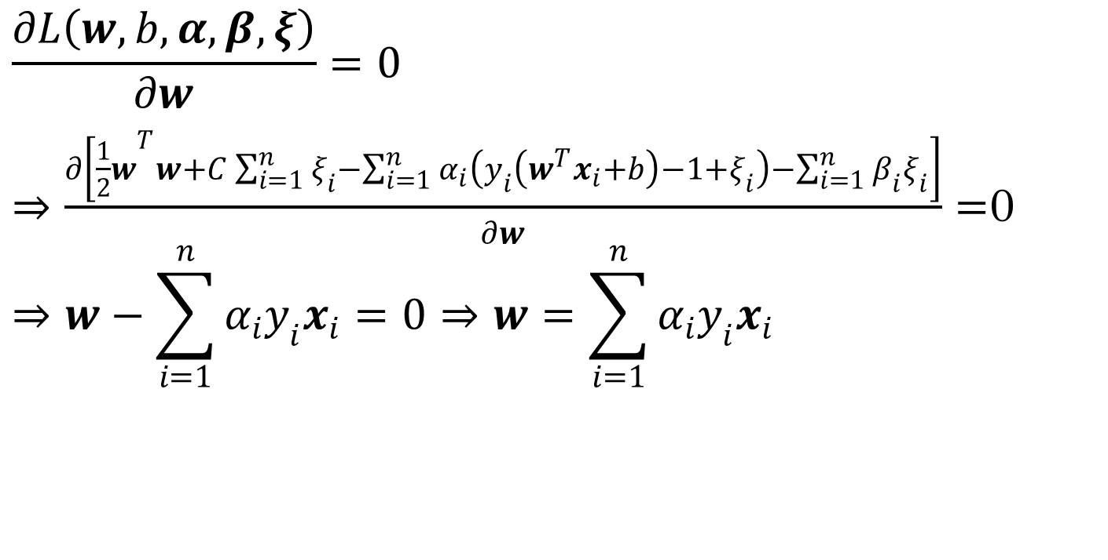
Dual Optimization (1/3)
$$\frac{∂L\left(w,b,α,β,ξ\right)}{∂w}=0$$ $⇒\frac{∂\left[{\frac{1}{2}w}^{T}w+C\sum_{i=1}^{n}{ξ_{i}}−\sum_{i=1}^{n}{α_{i}\left(y_{i}\left(w^{T}x_{i}+b\right)−1+ξ_{i}\right)}−\sum_{i=1}^{n}{β_{i}ξ_{i}}\right]}{∂w}=$0 $$⇒w−\sum_{i=1}^{n}{α_{i}y_{i}x_{i}=0}⇒w=\sum_{i=1}^{n}{α_{i}y_{i}x_{i}}$$

Slide 21

Dual Optimization (2/3)
$$\frac{∂L\left(w,b,α,β,ξ\right)}{∂b}=0$$ $⇒\frac{∂\left[{\frac{1}{2}w}^{T}w+C\sum_{i=1}^{n}{ξ_{i}}−\sum_{i=1}^{n}{α_{i}\left(y_{i}\left(w^{T}x_{i}+b\right)−1+ξ_{i}\right)}−\sum_{i=1}^{n}{β_{i}ξ_{i}}\right]}{∂b}=$0 $$⇒\sum_{i=1}^{n}{α_{i}y_{i}}=0$$

Slide 22

Dual Optimization (3/3)
$$\frac{∂L\left(w,b,α,β,ξ\right)}{∂ξ_{i}}=0$$ $⇒\frac{∂\left[{\frac{1}{2}w}^{T}w+C\sum_{i=1}^{n}{ξ_{i}}−\sum_{i=1}^{n}{α_{i}\left(y_{i}\left(w^{T}x_{i}+b\right)−1+ξ_{i}\right)}−\sum_{i=1}^{n}{β_{i}ξ_{i}}\right]}{∂ξ_{i}}=$0
$$⇒C−α_{i}−β_{i}=0$$

Slide 23
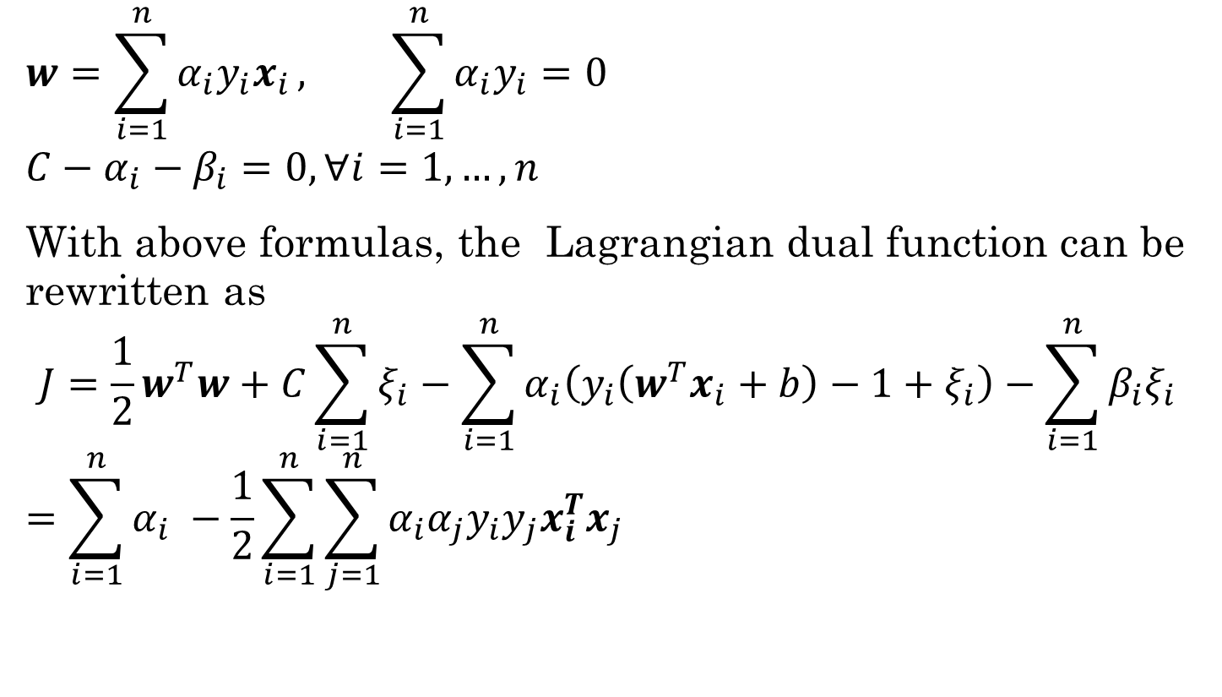
Dual Optimization
$$w=\sum_{i=1}^{n}{α_{i}y_{i}x_{i}}, \sum_{i=1}^{n}{α_{i}y_{i}}=0$$
$$C−α_{i}−β_{i}=0, ∀i=1,…,n$$
With above formulas, the Lagrangian dual function can be rewritten as
$$J={\frac{1}{2}w}^{T}w+C\sum_{i=1}^{n}{ξ_{i}}−\sum_{i=1}^{n}{α_{i}\left(y_{i}\left(w^{T}x_{i}+b\right)−1+ξ_{i}\right)}−\sum_{i=1}^{n}{β_{i}ξ_{i}}$$
$$=\sum_{i=1}^{n}{α_{i} }−\frac{1}{2}\sum_{i=1}^{n}{\sum_{j=1}^{n}{α_{i}α_{j}y_{i}y_{j}x_{i}^{T}x_{j}}}$$

Slide 24
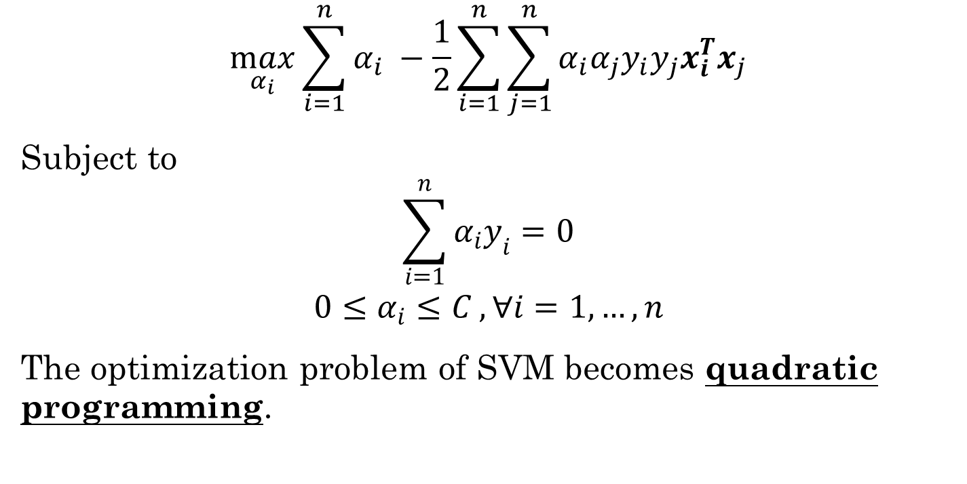
SVM (Dual Optimization)
$$\max_{α_{i}}{\sum_{i=1}^{n}{α_{i} }−\frac{1}{2}\sum_{i=1}^{n}{\sum_{j=1}^{n}{α_{i}α_{j}y_{i}y_{j}x_{i}^{T}x_{j}}}}$$
Subject to
$$\sum_{i=1}^{n}{α_{i}y_{i}}=0$$
$$0≤α_{i}≤C , ∀i=1,…,n$$
The optimization problem of SVM becomes quadratic programming.

Slide 25

Quadratic Programming
Quickly recall:
$$\min_{x}{f\left(x\right)}=\frac{1}{2}x^{T}Hx+c^{T}x$$
Subject to
$$A^{T}x≤b$$
$H:$Hessian matrix (symmetric)

Slide 26
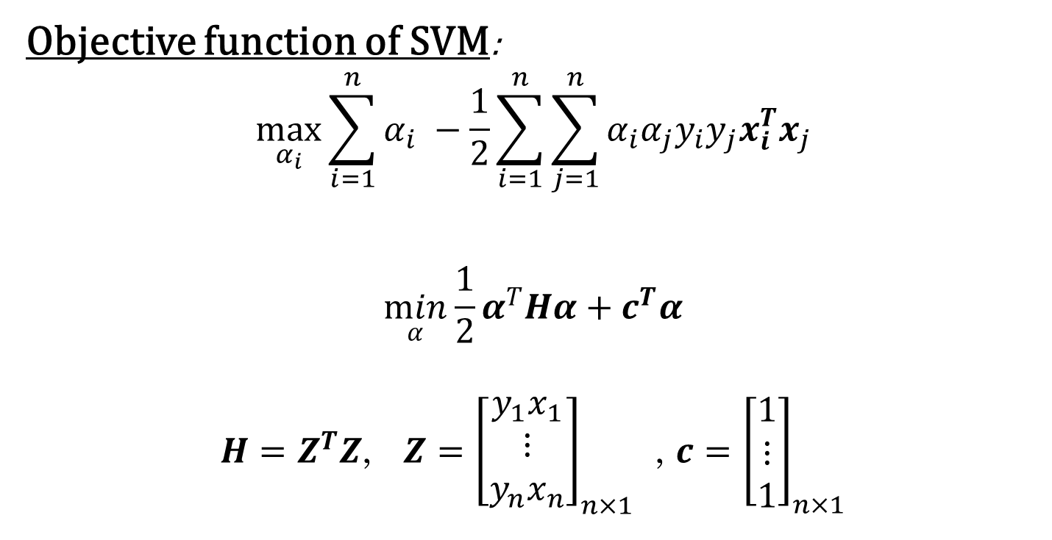
SVM - Quadratic Programming
Objective function of SVM:
$$\max_{α_{i}}{\sum_{i=1}^{n}{α_{i} }−\frac{1}{2}\sum_{i=1}^{n}{\sum_{j=1}^{n}{α_{i}α_{j}y_{i}y_{j}x_{i}^{T}x_{j}}}}$$
$$\min_{α}{\frac{1}{2}}α^{T}Hα+c^{T}α$$
$H=Z^{T}Z$, $Z={\left[\begin{matrix}y_{1}x_{1} \\ ⋮ \\ y_{n}x_{n}\end{matrix}\right]}_{n×1}$ , $c={\left[\begin{matrix}1 \\ ⋮ \\ 1\end{matrix}\right]}_{n×1}$

Slide 27

SVM - Quadratic Programming
Constraint
$$\sum_{i=1}^{n}{α_{i}y_{i}}=0$$
$$0≤α_{i}≤C , ∀i=1,…,n$$
$$A^{T}α=b$$
$$0≤α≤C$$
$A={\left[\begin{matrix}y_{1} \\ ⋮ \\ y_{n}\end{matrix}\right]}_{n×1} , b={\left[\begin{matrix}0 \\ ⋮ \\ 0\end{matrix}\right]}_{n×1}$, $α={\left[\begin{matrix}α_{1} \\ ⋮ \\ α_{n}\end{matrix}\right]}_{n×1}$

Slide 28
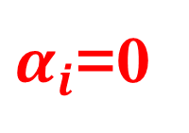
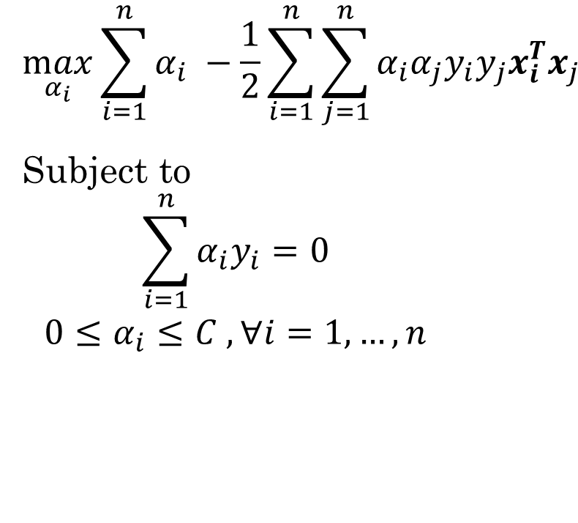
Support vectors
$$\max_{α_{i}}{\sum_{i=1}^{n}{α_{i} }−\frac{1}{2}\sum_{i=1}^{n}{\sum_{j=1}^{n}{α_{i}α_{j}y_{i}y_{j}x_{i}^{T}x_{j}}}}$$
Subject to
$$\sum_{i=1}^{n}{α_{i}y_{i}}=0$$
$$0≤α_{i}≤C , ∀i=1,…,n$$
v
$α_{i}$=0
margins
v
optimal hyperplane
Notes:
$$w=\sum_{i=1}^{n}{α_{i}y_{i}x_{i}}, \sum_{i=1}^{n}{α_{i}y_{i}}=0$$
$$C−α_{i}−β_{i}=0, ∀i=1,…,n$$

Slide 29


How to estimate $b$?
We hope all data
$$y_{i}\left(w^{T}x_{i}+b\right)≥1−ξ_{i}$$
But support vectors locate between margin
$$y_{i}\left(w^{T}x_{i}+b\right)=1−ξ_{i}$$
$$0<α_{i}≤C$$
Notes:
$$w=\sum_{i=1}^{n}{α_{i}y_{i}x_{i}}, \sum_{i=1}^{n}{α_{i}y_{i}}=0$$
$$C−α_{i}−β_{i}=0, ∀i=1,…,n$$

Slide 30

How to estimate $b$?
$$\left(y_{t}\left(w^{T}x_{t}+b\right)−1+ξ_{t}\right)=0,α_{t}>0, ξ_{t}=0$$
$$b=y_{t}−\sum_{j=1}^{n}{α_{j}y_{j}x_{j}^{T}x_{t}}, ∀t=1,…,n_{sv}$$
Notes:
$$w=\sum_{i=1}^{n}{α_{i}y_{i}x_{i}}, \sum_{i=1}^{n}{α_{i}y_{i}}=0$$
$$C−α_{i}−β_{i}=0, ∀i=1,…,n$$

Slide 31
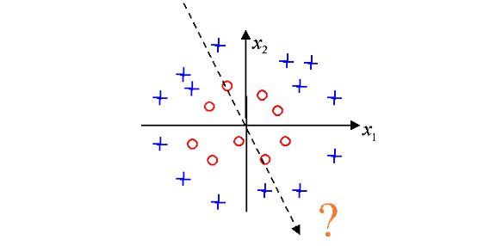
Kernel Trick
We just introduce the linear SVM, and however, most of cases are not linear separable.

Slide 32
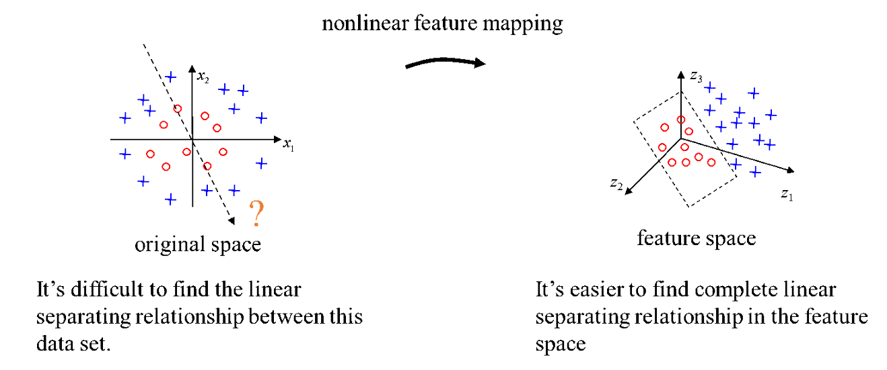

Kernel Trick
$$z=φ(x)$$

Slide 33
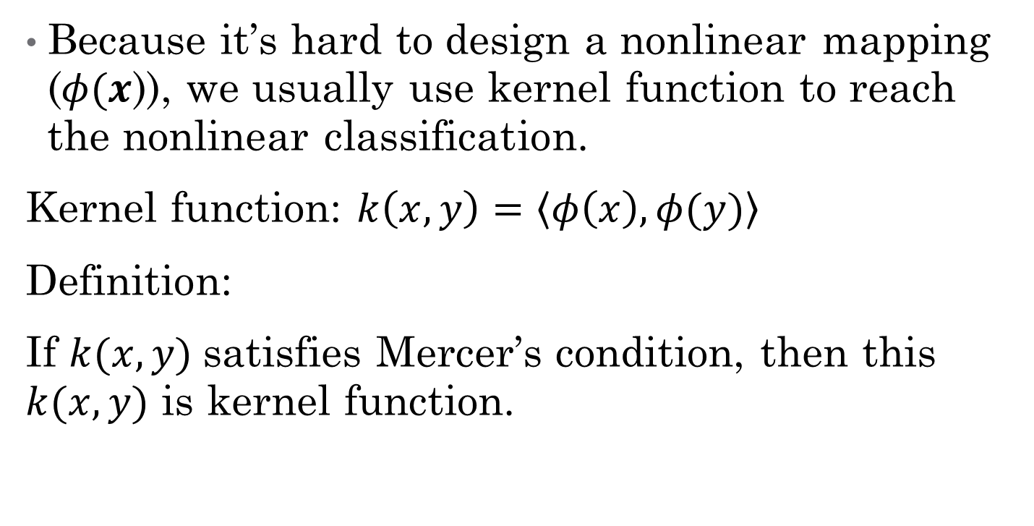
Kernel function
Because it’s hard to design a nonlinear mapping ($φ(x$)), we usually use kernel function to reach the nonlinear classification.
Kernel function: $k\left(x,y\right)=\left\langle φ\left(x\right),φ(y)\right\rangle$
Definition:
If $k(x,y)$satisfies Mercer’s condition, then this $k(x,y)$ is kernel function.

Slide 34
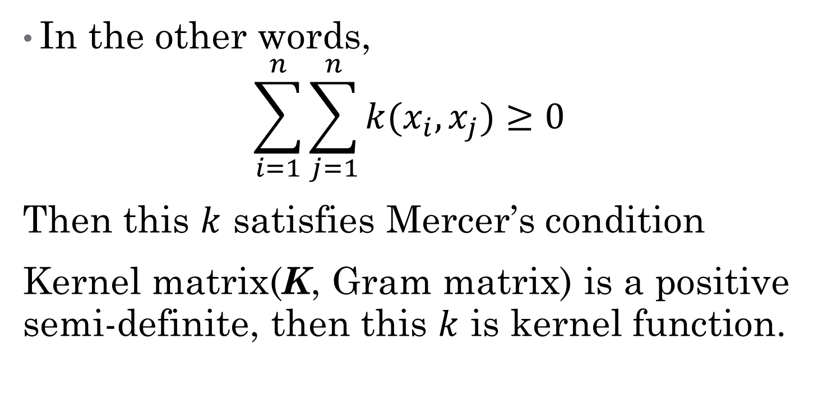
Kernel function
In the other words,
$$\sum_{i=1}^{n}{\sum_{j=1}^{n}{k(x_{i},x_{j})}≥0}$$
Then this $k$ satisfies Mercer’s condition
Kernel matrix(K, Gram matrix) is a positive semi-definite, then this $k$ is kernel function.

Slide 35
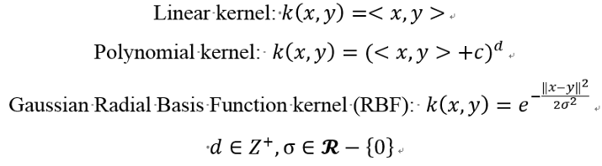
Kernel function

Slide 36
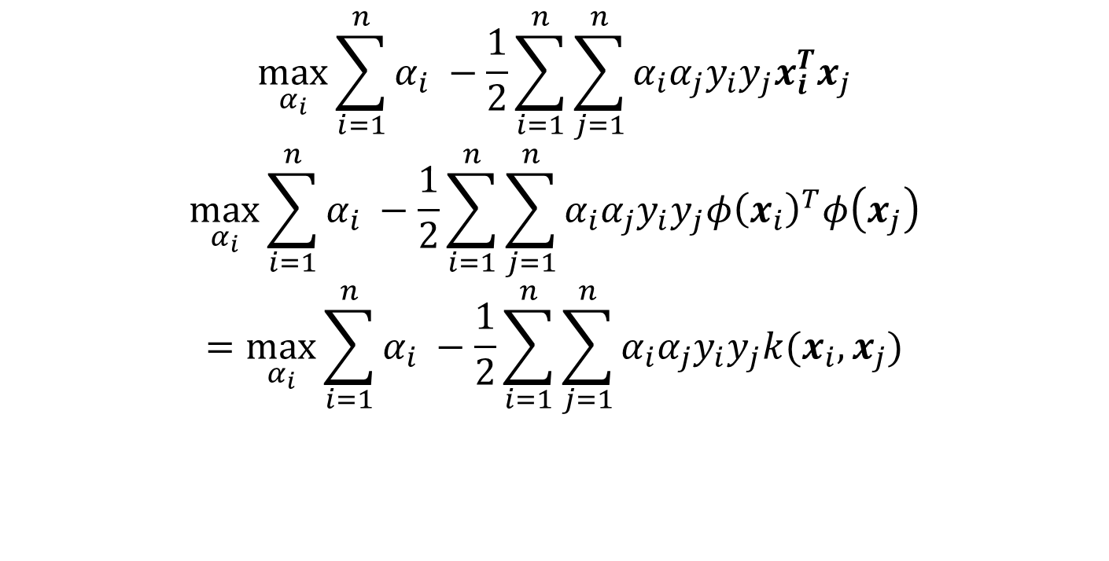
SVM with kernel function
$$\max_{α_{i}}{\sum_{i=1}^{n}{α_{i} }−\frac{1}{2}\sum_{i=1}^{n}{\sum_{j=1}^{n}{α_{i}α_{j}y_{i}y_{j}x_{i}^{T}x_{j}}}}$$
$$\max_{α_{i}}{\sum_{i=1}^{n}{α_{i} }−\frac{1}{2}\sum_{i=1}^{n}{\sum_{j=1}^{n}{α_{i}α_{j}y_{i}y_{j}{φ\left(x_{i}\right)}^{T}φ\left(x_{j}\right)}}}$$
$$=\max_{α_{i}}{\sum_{i=1}^{n}{α_{i} }−\frac{1}{2}\sum_{i=1}^{n}{\sum_{j=1}^{n}{α_{i}α_{j}y_{i}y_{j}k(x_{i},x_{j})}}}$$

Slide 37
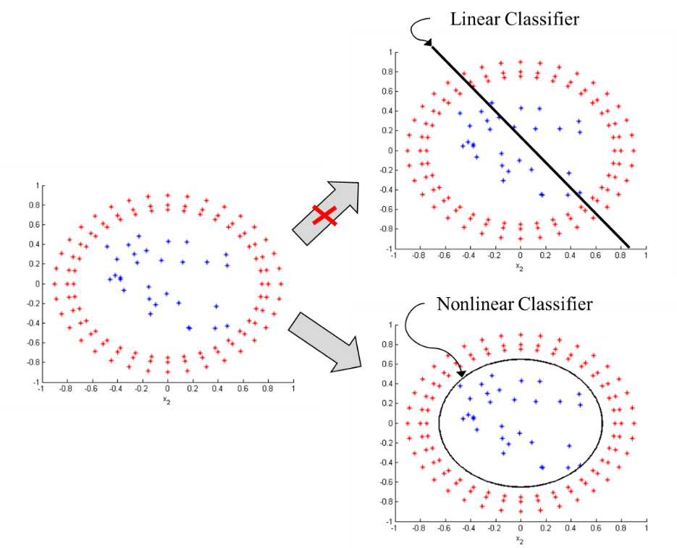
Example for kernel function

Slide 38

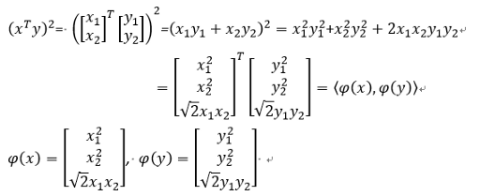
Example for polynomial kernel function
polynomial kernel function次方項為2次方，截距為0 (d=2, c=0)的例子。

Slide 39
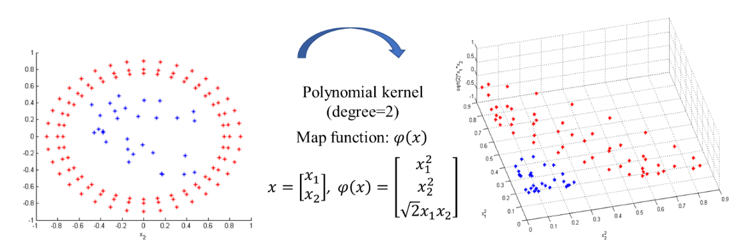
Example for polynomial kernel function

Slide 40
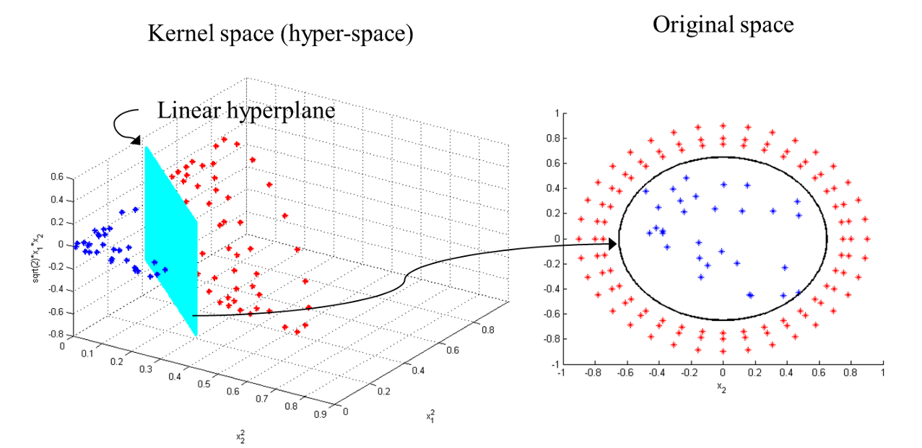
Example for polynomial kernel function

Slide 41
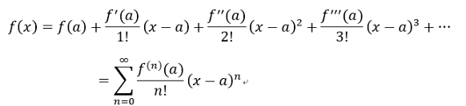

Example for RBF kernel function
Recall: Taylor series
In RBF, we need to use

Slide 42
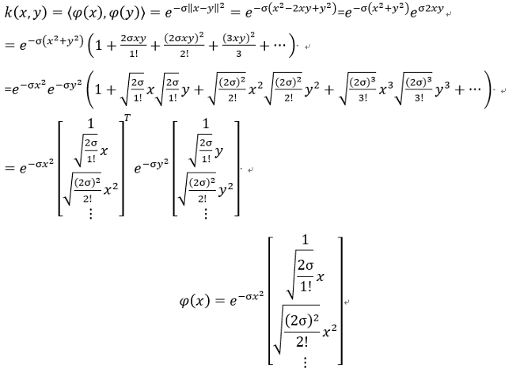
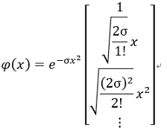
Example for RBF kernel function

Slide 43

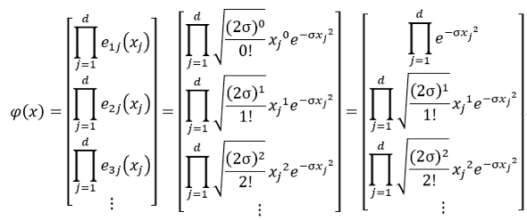
Example for RBF kernel function

Slide 44
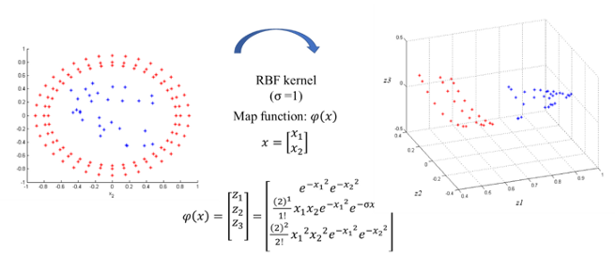
Example for RBF kernel function

Slide 45
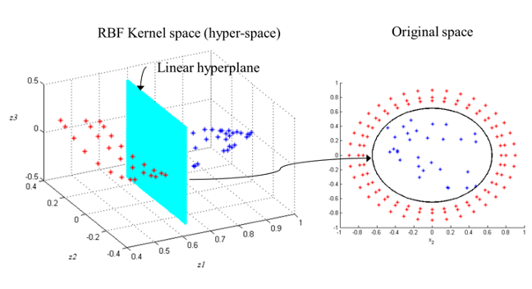
Example for RBF kernel function

Slide 46
Summary
In SVM, we still need to choice
C for slack variable.
Kernel function.
In empirical, RBF kernel most has better result. But there is a parameter (σ).
Grid Search is a common trick, but it’s time- consuming.

